Slide 1
Lesson 6: Functions
Topics to be covered.
Defintion of a function
One-to-One Functions
Onto Functions
Inverse Functions
Composition of Functions
Some Important Functions
Partial Functions

Slide 2
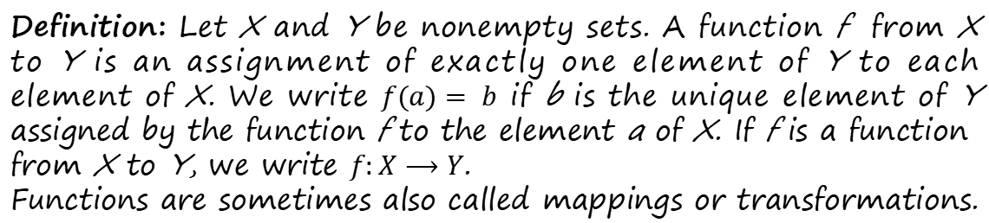
Functions
Linda
A
Max
B
Kathy
Peter
C
Nimal
D
Jams
F
X
Y
Definition: Let X and Y be nonempty sets. A function f from X to Y is an assignment of exactly one element of Y to each element of X. We write $f(a)= b$ if b is the unique element of Y assigned by the function f to the element a of X. If f is a function from X to Y, we write $f:X⟶Y$.
Functions are sometimes also called mappings or transformations.

Slide 3
Rquirement of functions
An element of the set X cannot be mapped with two different elements in y as shown in the following figure.
Every element of the set x must be mapped with an element with Y subjected to the above condition.
However there may be lements in y which are not assigned with elements of x from the function.
Linda
A
B
C
D
F
X
Y

Slide 4
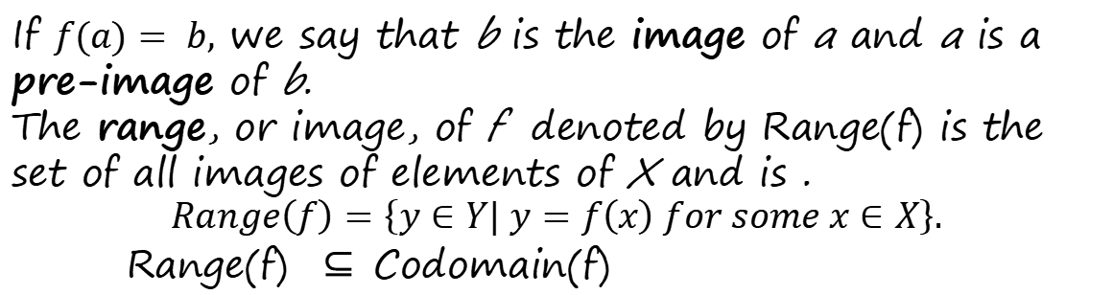
Terminology
X
Y
f
Linda
A
Domain
Max
B
Codomain
Kathy
Peter
C
Nimal
D
Jams
F
If $f(a)= b,$we say that b is the image of a and a is a pre-image of b.
The range, or image, of f denoted by Range(f) is the set of all images of elements of X and is .
$$Range\left(f\right)=\left\{y∈Y| y=f\left(x\right) for some x∈X\right\}.$$
Range(f) ⊆ Codomain(f)

Slide 5
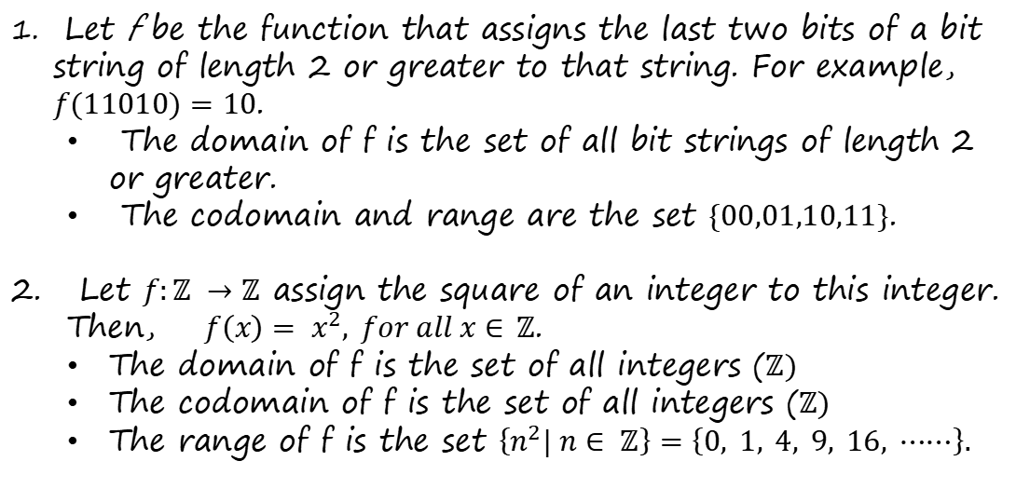
Examples
Find the domain, codomain and range of the following functions:
Let f be the function that assigns the last two bits of a bit string of length 2 or greater to that string. For example, $f(11010)=10$.
The domain of f is the set of all bit strings of length 2 or greater.
The codomain and range are the set $\{00,01,10,11\}$.
Let $f:ℤ →ℤ$ assign the square of an integer to this integer. Then, $f\left(x\right)= x^{2}, for all x∈$ $ℤ$.
The domain of f is the set of all integers ($ℤ)$
The codomain of f is the set of all integers ($ℤ)$
The range of f is the set $\left\{n^{2}| n∈ ℤ\right\}=\left\{0, 1, 4, 9, 16, ⋯⋯\right\}.$

Slide 6
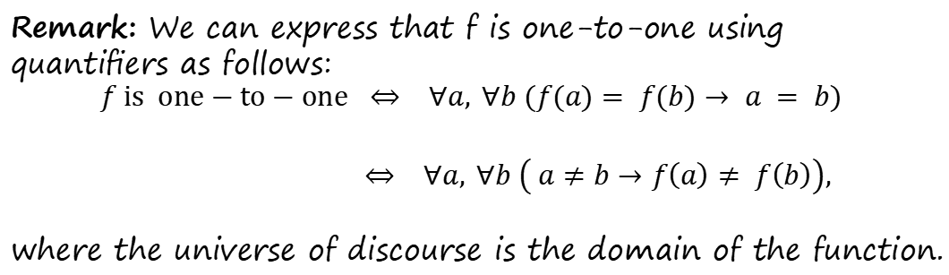
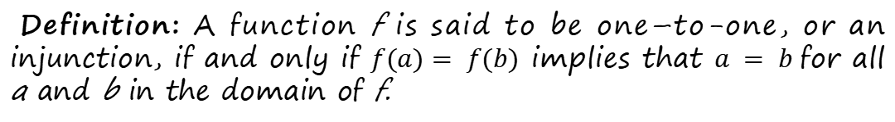
One to one function
Some functions never assign the same co-domain value to two different domain elements. These functions are said to be one-to-one.
Definition: A function f is said to be one–to-one, or an injunction, if and only if $f(a)= f(b)$ implies that $a = b$for all a and b in the domain of f.
Remark: We can express that f is one-to-one using quantiﬁers as follows:
$$f is one−to−one ⇔ ∀a, ∀b (f(a)= f(b)→ a = b)$$
$⇔ ∀a, ∀b \left( a≠b→f\left(a\right)≠ f\left(b\right)\right),$
where the universe of discourse is the domain of the function.

Slide 7
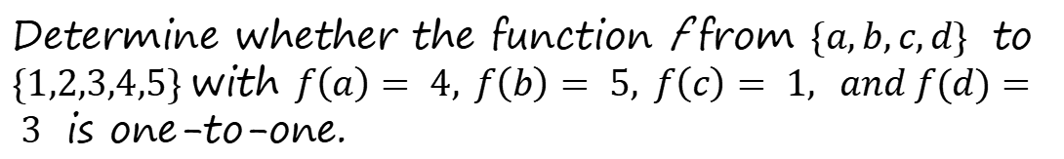
Example
Determine whether the function f from $\{a,b,c,d\}$ to $\{1,2,3,4,5\}$with $f\left(a\right)= 4, f\left(b\right)= 5, f\left(c\right)= 1, and f(d)= 3$ is one-to-one.
a
1
2
b
3
c
4
d
5
The function f is one to one because f assignes different values to the elements of its domain.

Slide 8


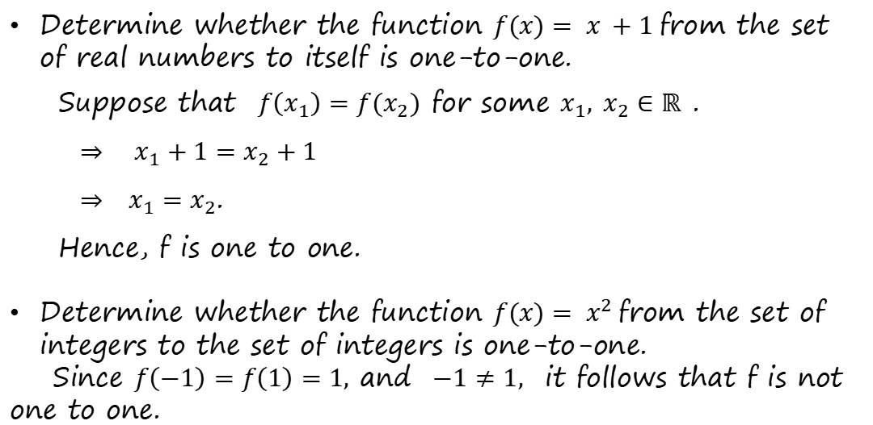
Examples
Determine whether the function $f(x)= x +1$from the set of real numbers to itself is one-to-one.
Suppose that $f\left(x_{1}\right)=f(x_{2})$ for some $x_{1}, x_{2}∈ℝ$ .
$⇒ x_{1}+1=x_{2}+1$
$⇒ x_{1}=x_{2}$.
Hence, f is one to one.
Determine whether the function $f(x)= x^{2}$from the set of integers to the set of integers is one-to-one.
Since $f\left(−1\right)=f\left(1\right)=1,$and $−1≠1,$ it follows that f is not one to one.
$$y$$
$$x$$

Slide 9
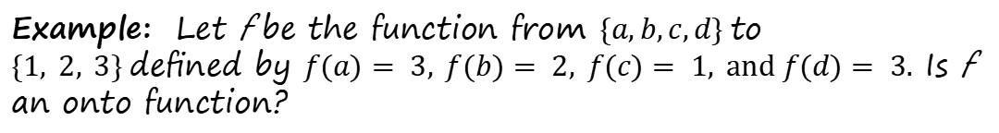
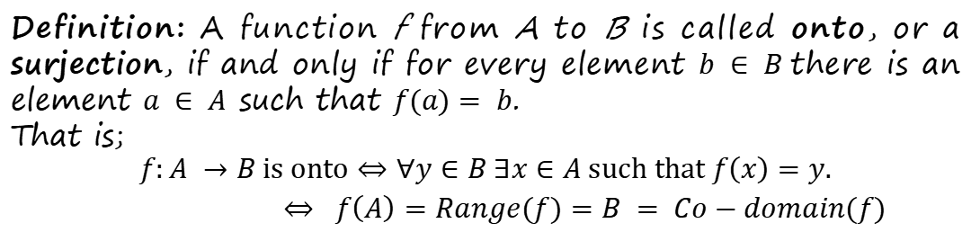
Onto Functions
Definition: A function f from A to B is called onto, or a surjection, if and only if for every element $b ∈ B$there is an element $a ∈ A$ such that $f(a)= b$.
That is;
$$f:A →B is onto⇔∀y∈B ∃x∈A such that f\left(x\right)=y.$$
$⇔ f\left(A\right)=Range(f)=B = Co−domain(f)$
Example: Let f be the function from $\{a,b,c,d\}$to $\{1, 2, 3\}$deﬁned by $f(a)= 3, f(b)= 2, f(c)= 1, and f(d)= 3.$Is f an onto function?
a
1
Because all three elements of the codomain are images of elements in the domain, f is an onto function.
b
2
c
3
d

Slide 10
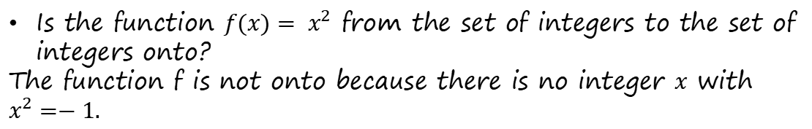


Examples
Is the function $f(x)=2x +1$from the set of real numbers to the set of real numbers onto?
Solution: Let $y∈ℝ$ be arbitrary.
Then $x=\frac{y−1}{2}∈ℝ$ and f(x) = y
$f\left(x\right)=f\left(\frac{y−1}{2}\right)=y−1+1=y.$
Hence, $∀y∈ℝ ∃x∈ℝ such that f\left(x\right)=y.$
Therefore $f$ is onto.
$$f\left(x\right)=y$$
$$⇒ 2x+1=y$$
$$⇒ x=\frac{y−1}{2}$$
Is the function $f(x)= x^{2}$ from the set of integers to the set of integers onto?
The function f is not onto because there is no integer $x$ with $x^{2}=−1.$

Slide 11
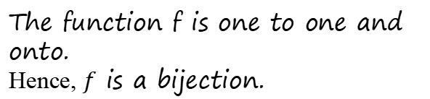
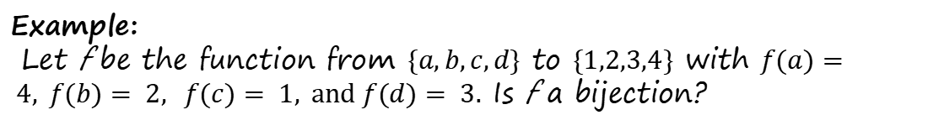
One to one correspondence or Bijection
Definition: A function $f:A ⟶B$ is a bijection, if and only if it is both one to one and onto.
Example:
Let f be the function from $\{a,b,c,d\}$ to $\{1,2,3,4\}$ with $f(a)= 4, f(b)= 2, f(c)= 1, and f(d)= 3.$ Is f a bijection?
a
1
The function f is one to one and
onto.
Hence, $f$ is a bijection.
b
2
c
3
d
4

Slide 12
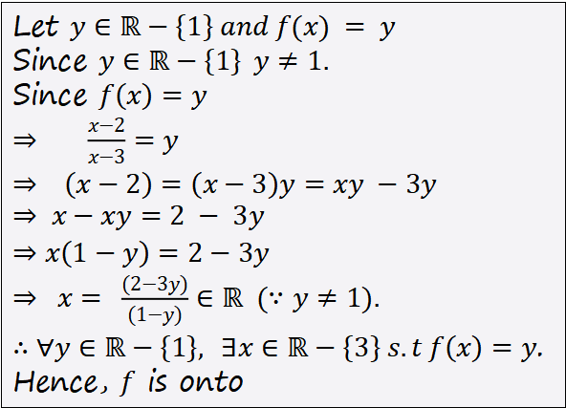
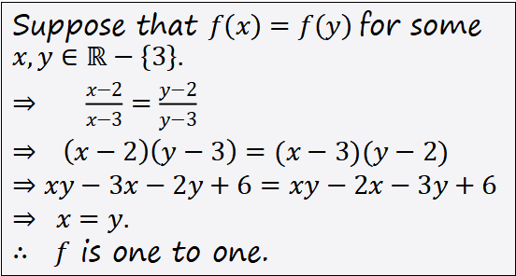
Example
Consider the function $f: ℝ−\left\{3\right\} ⟶ℝ−\left\{1\right\}$ defined by
$f\left(x\right)=\left(\frac{x−2}{x−3}\right), ∀x ℝ−\left\{3\right\}$. Is $f$a bijection? Justify your answer.
Suppose that $f\left(x\right)=f\left(y\right)$for some $x,y∈ℝ−\left\{3\right\}\text{.}$
$⇒ \frac{x−2}{x−3}=\frac{y−2}{y−3}$
$⇒ \left(x−2\right)\left(y−3\right)=(x−3)(y−2)$
$⇒xy−3x−2y+6=xy−2x−3y+6$
$⇒ x=y.$
$∴ f$ is one to one.
Let $y∈ℝ−\left\{1\right\} and f(x) = y$
Since $y∈ℝ−\left\{1\right\}$ $y≠1.$
Since $f\left(x\right)=y$
$⇒ \frac{x−2}{x−3}=y$
$⇒ \left(x−2\right)=\left(x−3\right)y=xy −3y$
$$⇒ x−xy=2 − 3y$$
$⇒x\left(1−y\right)=2−3y$
$⇒ x= \frac{(2−3y)}{(1−y)}∈ℝ (∵y≠1).$
$∴∀y∈ℝ−\left\{1\right\}, ∃x∈ℝ−\left\{3\right\} s.t f\left(x\right)=y$.
Hence, $f$ is onto
Since $f$ is one to one and onto, $f$ is a bijection.

Slide 13
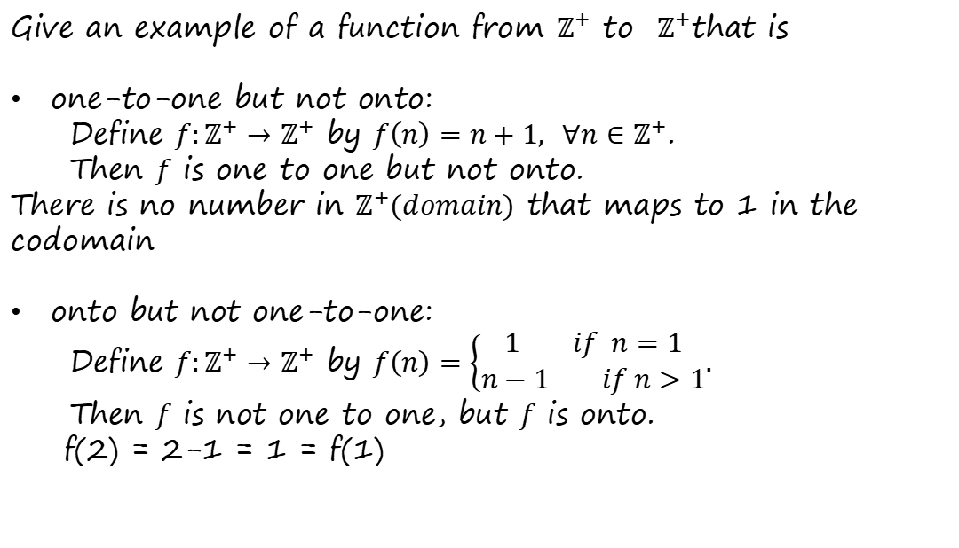
Exercise
Give an example of a function from $ℤ^{+}$ to $ℤ^{+}$that is
one-to-one but not onto:
Define $f:ℤ^{+}→ℤ^{+}$ by $f\left(n\right)=n+1, ∀n∈ℤ^{+}$.
Then $f$ is one to one but not onto.
There is no number in $ℤ^{+}(domain)$ that maps to 1 in the codomain
onto but not one-to-one:
Define $f:ℤ^{+}→ℤ^{+}$ by $f\left(n\right)=\left\{\begin{matrix}1 if n=1 \\ n−1 if n>1\end{matrix}.\right.$
Then $f$ is not one to one, but $f$ is onto.
f(2) = 2-1 = 1 = f(1)

Slide 14
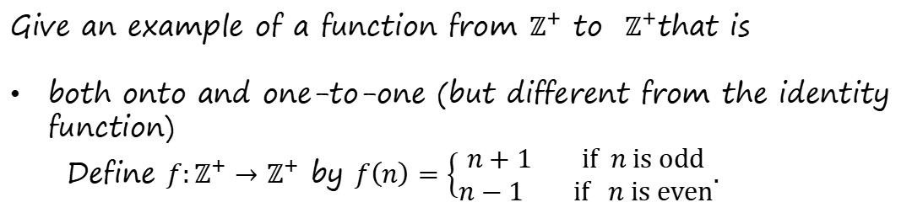
Exercise
Give an example of a function from $ℤ^{+}$ to $ℤ^{+}$that is
both onto and one-to-one (but different from the identity function)
Define $f:ℤ^{+}→ℤ^{+}$ by $f\left(n\right)=\left\{\begin{matrix}n+1 if n is odd \\ n−1 if n is even\end{matrix}.\right.$

Slide 15



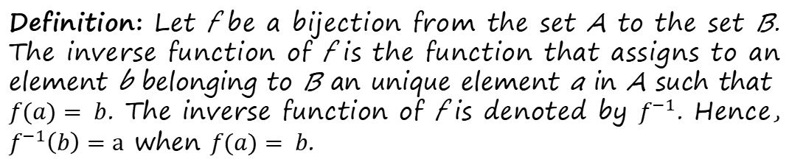
Inverse Functions
An interesting property of bijections is that they have an inverse function.
Definition: Let f be a bijection from the set A to the set B. The inverse function of f is the function that assigns to an element b belonging to B an unique element a in A such that $f(a)= b$. The inverse function of f is denoted by $f^{−1}$. Hence, $f^{−1}\left(b\right)=a$ when $f(a)= b$.
A
B
Linda
$a=f^{−1}(b)$
$$b=f(a)$$
f
$$f^{−1}$$

Slide 16


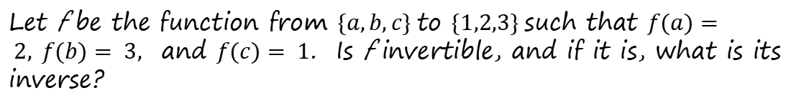
Example
Let f be the function from $\{a,b,c\}$to $\{1,2,3\}$such that $f(a)= 2, f(b)= 3,$ and $f(c)= 1$. Is f invertible, and if it is, what is its inverse?
a
1
1
a
b
2
2
b
c
3
3
c
$f:A$ $⟶ B$
$f^{−1}:B$ $⟶ A$

Slide 17
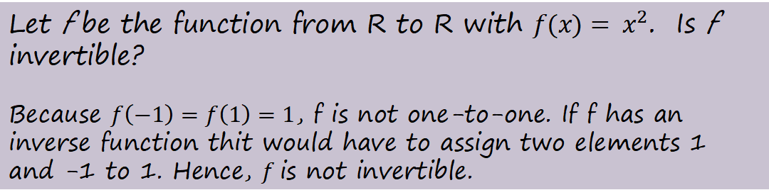
Examples
Let f be the function from R to R with $f(x)= x^{2}$. Is f invertible?
Because $f\left(−1\right)=f\left(1\right)=1$, f is not one-to-one. If f has an inverse function thit would have to assign two elements 1 and -1 to 1. Hence, $f$is not invertible.

Slide 18
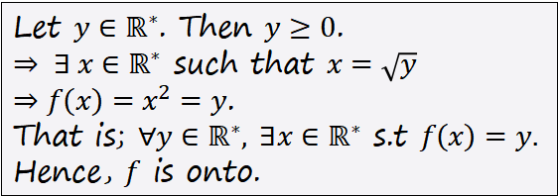
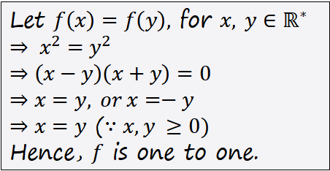
Examples
Let $f:ℝ^{∗}⟶ℝ^{∗}$ be the function defined by $f(x)= x^{2}$, where $ℝ^{∗}=\left\{x∈ℝ | x≥0\right\}$ Is f invertible?
Let $f\left(x\right)=f\left(y\right),$ for $x, y∈ℝ^{∗}$
$⇒ x^{2}=y^{2}$
$⇒\left(x−y\right)\left(x+y\right)=0$
$⇒x=y, or x=−y$
$⇒x=y$ ($∵x,y ≥0)$
Hence, $f$ is one to one.
Let$y∈ℝ^{∗}$. Then $y≥0$.
$⇒ ∃ x∈ℝ^{∗}$ such that $x=\sqrt{y}$
$⇒f\left(x\right)=x^{2}=y$.
That is; $∀y∈ℝ^{∗}, ∃x∈ℝ^{∗}$ s.t $f\left(x\right)=y.$
Hence, $f$ is onto.
Since, f is one to one and onto f is invertible and
$f^{−1}\left(y\right) =\sqrt{y}, ∀y∈ℝ^{∗}$.

Slide 19







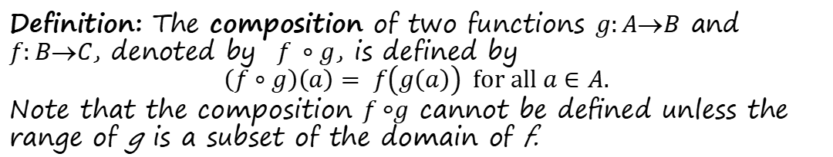
Compositions of Functions
$$(f∘g)(a)$$
Linda
Linda
Linda
$$∙$$
$$a$$
$$∙$$
$$g(a)$$
$$∙$$
$$f(g\left(a\right))$$
$$g$$
$$f$$
A
B
C
$$f∘g$$
Definition: The composition of two functions $g:AB$ and $f:BC$, denoted by $f ∘g$, is defined by
$$\left(f∘g\right)\left(a\right)= f\left(g\left(a\right)\right) for all a∈A.$$
Note that the composition $f ◦g$ cannot be deﬁned unless the range of g is a subset of the domain of f.

Slide 20



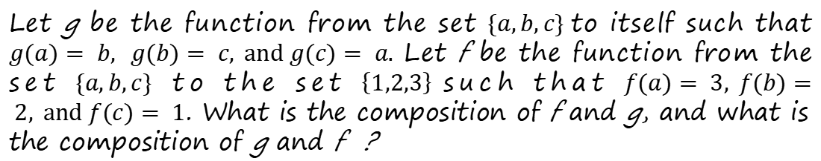
Example
Let g be the function from the set $\{a,b,c\}$to itself such that $g(a)= b, g(b)= c, and g(c)= a.$Let f be the function from the set $\{a,b,c\}$ to the set $\left\{1,2,3\right\}$such that $f(a)= 3, f(b)= 2, and f(c)= 1$. What is the composition of f and g, and what is the composition of g and f ?
a
1
a
a
1
b
2
b
b
2
c
3
c
c
3
$A$
$$B$$
$$f∘g$$
$A$
$$g$$
$A$
$$f$$
$$B$$
Note that g ◦ f is not defined, because the range of f=(1,2,3} is not a subset of the domain of g ={a,b,c}.

Slide 21
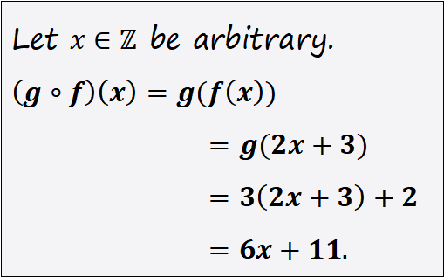
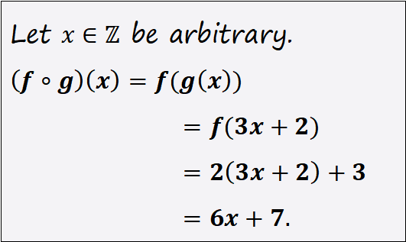
Example
Let f and g be the functions from the set of integers to the set of integers deﬁned by 𝑓(𝑥)= 2𝑥 +3 and 𝑔(𝑥)= 3𝑥 +2. What is the composition of f and g? What is the composition of g and f ?
Let $x∈ℤ$ be arbitrary.
$\left(f∘g\right)\left(x\right)=f(g\left(x\right))$
$=f(3x+2)$
$=2\left(3x+2\right)+3$
$=6x+7.$
Let $x∈ℤ$ be arbitrary.
$\left(g∘f\right)\left(x\right)=g(f\left(x\right))$
$=g(2x+3)$
$=3\left(2x+3\right)+2$
$=6x+11.$
Note that even though f ◦ g and g ◦ f are defined for the functions f and g, f ◦ g and g ◦ f are not equal.

Slide 22
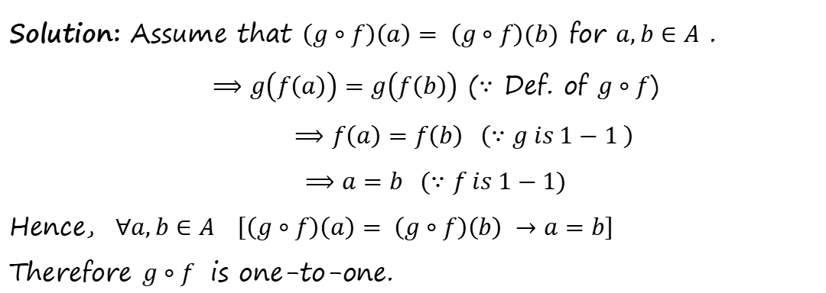
More Examples
Let $f: A → B$and $g: B → C$be both one to one functions. Show that $g∘f:A→C$ is one to one.
Solution: Assume that $\left(g∘f\right)\left(a\right)= \left(g∘f\right)(b)$ for $a,b∈A$ .
$⟹g\left(f\left(a\right)\right)=g\left(f\left(b\right)\right)$ ($∵$ Def. of $g∘f$)
$⟹f\left(a\right)=f\left(b\right) \left(∵g is 1−1 \right)$
$⟹a=b (∵f is 1−1)$
Hence, $∀a,b∈A \left[\left(g∘f\right)\left(a\right)= \left(g∘f\right)\left(b\right) →a=b\right]$
Therefore $g∘f$ is one-to-one.
Exercise: Let $f: A → B$and $g: B → C$be both onto functions. Show that $g∘f:A→C$ is onto.

Slide 23
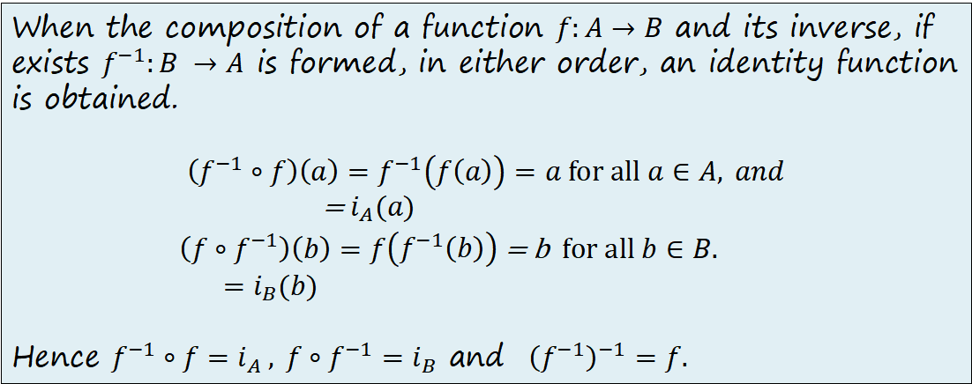
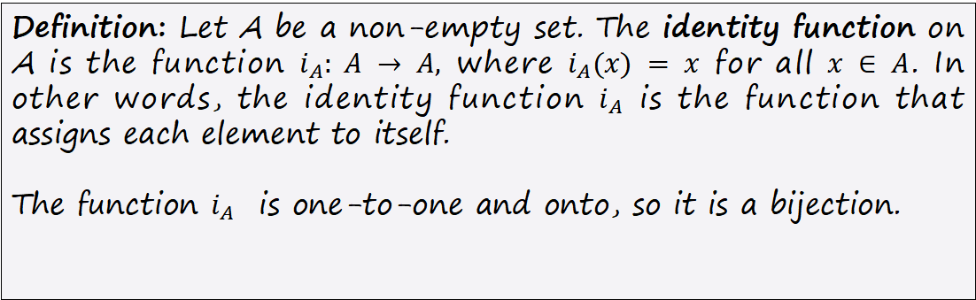
Identity Function
Definition: Let A be a non-empty set. The identity function on A is the function $i_{A}: A → A,$ where $i_{A}(x) = x$ for all $x ∈ A$. In other words, the identity function $i_{A}$ is the function that assigns each element to itself.
The function $i_{A}$ is one-to-one and onto, so it is a bijection.
When the composition of a function $f:A→B$ and its inverse, if exists $f^{−1}:B →A$ is formed, in either order, an identity function is obtained.
$$\left(f^{−1}∘f\right)\left(a\right)=f^{−1}\left(f\left(a\right)\right)=a for all a∈A, and$$
= $i_{A}(a)$
$\left({f∘f}^{−1}\right)\left(b\right)=f\left(f^{−1}\left(b\right)\right)$ = b $for all b∈B.$
$=i_{B}(b)$
Hence $f^{−1}∘f=i_{A} , {f∘f}^{−1}=i_{B}$ and ${\left(f^{−1}\right)}^{−1}=f.$

Slide 24
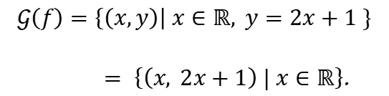



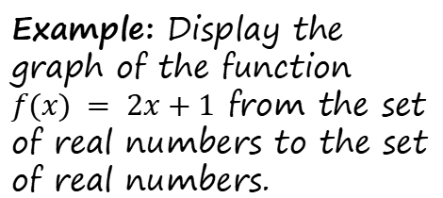
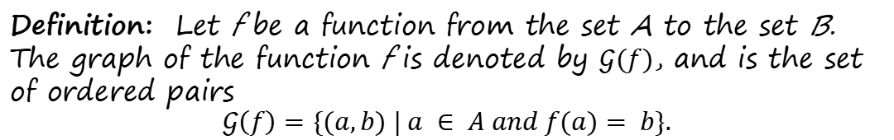
The Graphs of Functions
Definition: Let f be a function from the set A to the set B. The graph of the function f is denoted by $𝒢(f)$, and is the set of ordered pairs
$$𝒢\left(f\right)=\{(a,b) | a ∈ A and f(a)= b\}.$$
$$y$$
$$y=2x+1$$
Example: Display the graph of the function $f(x) = 2x+1$ from the set of real numbers to the set of real numbers.
$$x$$
$$𝒢\left(f\right)=\left\{\left(x,y\right)\right| x∈ℝ, y=2x+1 \}$$
$= \left\{\left(x, 2x+1\right) | x∈ℝ\right\}$.

Slide 25
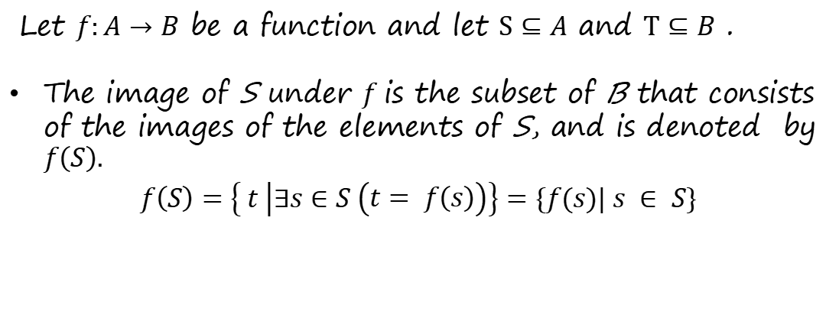
The Image and Inverse Image of a Subset of the Domain & the Codomain Respectively
Let $f:A→B$ be a function and let $S⊆A$ and $T⊆B$ .
The image of S under $f$is the subset of B that consists of the images of the elements of S, and is denoted by $f\left(S\right).$
$f\left(S\right)=\left\{ t | ∃s∈S \left(t= f\left(s\right)\right)\right\}=\{f(s)| s ∈ S\}$

Slide 26
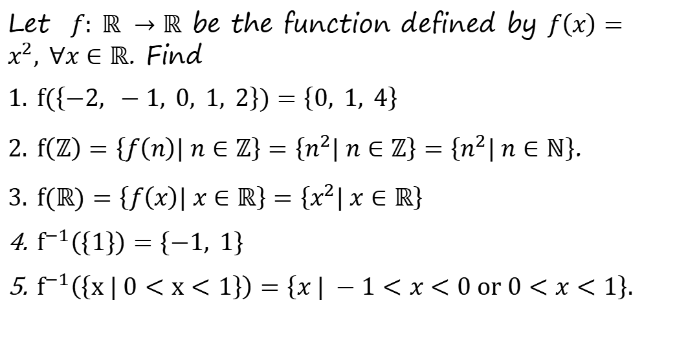
Example -2
Let $f: ℝ →ℝ$ be the function defined by $f\left(x\right)=x^{2}, ∀x∈ℝ$. Find
$f(\left\{−2, −1, 0, 1, 2\right\})=\left\{0, 1, 4\right\}$
$f\left(ℤ\right)=\left\{f\left(n\right)| n∈ℤ\right\}=\left\{n^{2}| n∈ℤ\right\}=\left\{n^{2}| n∈ℕ\right\}$.
$f(ℝ)=\left\{f\left(x\right)| x∈ℝ\right\}=\left\{x^{2}| x∈ℝ\right\}$
$f^{−1}\left(\left\{1\right\}\right)=\left\{−1, 1\right\}$
$f^{−1}\left(\left\{x | 0<x<1\right\}\right)=\left\{x | −1<x<0 or 0<x<1\right\}.$

Slide 27
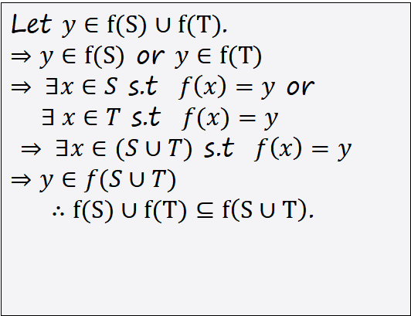
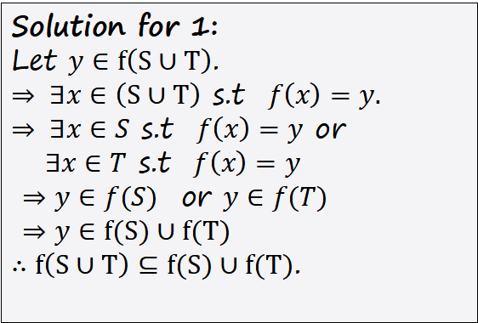
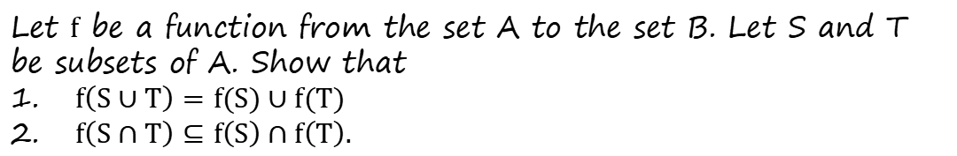
Exercise -1
Let $f$ be a function from the set A to the set B. Let S and T be subsets of A. Show that
$f\left(S∪T\right)=f(S)∪f(T)$
$f\left(S∩T\right)⊆f\left(S\right)∩f\left(T\right).$
Solution for 1:
Let $y∈f\left(S∪T\right)$.
$⇒ ∃x∈\left(S∪T\right)$ s.t $f\left(x\right)=y.$
$⇒ ∃x∈S$ s.t $f\left(x\right)=y$ or
$∃x∈T$ s.t $f\left(x\right)=y$
$⇒y∈f(S)$ or $y∈f(T)$
$⇒y∈f(S)∪f(T)$
$∴f\left(S∪T\right)⊆f(S)∪f(T)$.
Let $y∈f(S)∪f(T)$.
$⇒y∈f(S)$ or $y∈f(T)$
$⇒ ∃x∈S$ s.t $f\left(x\right)=y$ or
$∃ x∈T$ s.t $f(x)=y$
$⇒ ∃x∈(S∪T)$ s.t $f\left(x\right)=y$
$⇒y∈f(S∪T)$
$∴f(S)∪f(T)⊆f\left(S∪T\right)$.

Slide 28
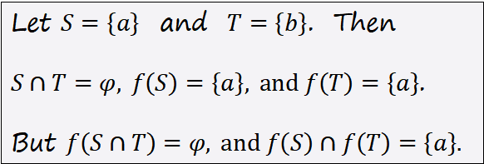
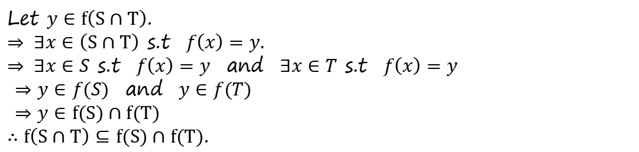
Solution for 2:
Let $y∈f\left(S∩T\right)$.
$⇒ ∃x∈\left(S∩T\right)$ s.t $f\left(x\right)=y.$
$⇒ ∃x∈S$ s.t $f\left(x\right)=y$ and $∃x∈T$ s.t $f\left(x\right)=y$
$⇒y∈f(S)$ and $y∈f(T)$
$⇒y∈f(S)∩f(T)$
$∴f\left(S∩T\right)⊆f(S)∩f(T)$.
Let f be the function defined by the following diagram:
a
a
Let $S=\left\{a\right\}$ and $T=\left\{b\right\}$. Then
$S∩T=φ, f\left(S\right)=\left\{a\right\}, and f\left(T\right)=\left\{a\right\}$.
But $f\left(S∩T\right)=φ, and f\left(S\right)∩f\left(T\right)=\left\{a\right\}.$
b
b
$A$
$A$

Slide 29
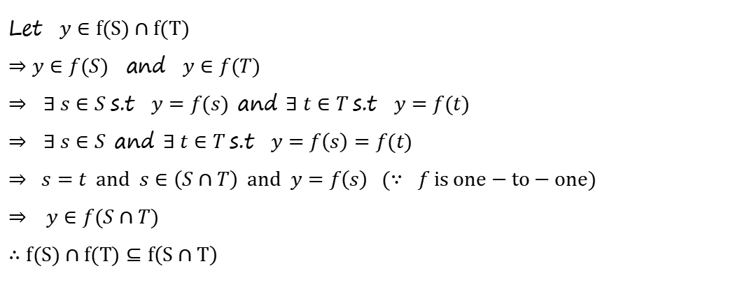
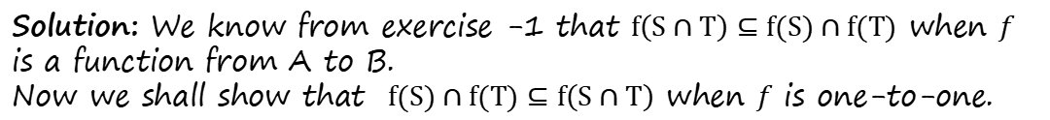
Exercise -2
Let $f$ be a one-to-one function from the set A to the set B. Let S and T be subsets of A. Show that $f\left(S∩T\right)=f\left(S\right)∩f\left(T\right)$.
Solution: We know from exercise -1 that $f\left(S∩T\right)⊆f(S)∩f(T)$ when $f$ is a function from A to B.
Now we shall show that $f(S)∩f(T)⊆f\left(S∩T\right)$ when $f$ is one-to-one.
Let $y∈f(S)∩f(T)$
$⇒y∈f(S)$ and $y∈f(T)$
$⇒$ $∃ s∈S$s.t $y=f(s)$ and $∃ t∈T$s.t $y=f(t)$
$⇒$ $∃ s∈S$ and $∃ t∈T$s.t $y=f\left(s\right)=f(t)$
$⇒ s=t and s∈\left(S∩T\right) and y=f\left(s\right) (∵ f is one−to−one)$
$⇒ y∈f(S∩T)$
$∴f(S)∩f(T)⊆f\left(S∩T\right)$

Slide 30
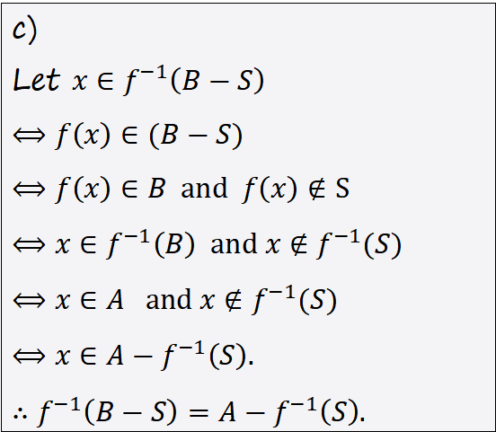
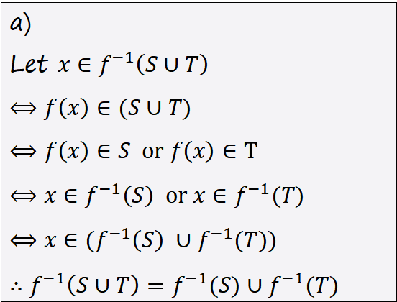
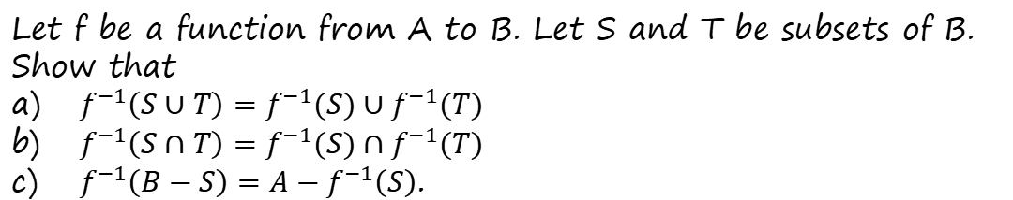
Example
Let f be a function from A to B. Let S and T be subsets of B. Show that
$f^{−1}\left(S∪T\right)=f^{−1}(S)∪f^{−1}(T)$
$f^{−1}\left(S∩T\right)=f^{−1}(S)∩f^{−1}(T)$
$f^{−1}\left(B−S\right)=A−f^{−1}\left(S\right)$.
c)
Let $x∈f^{−1}\left(B−S\right)$
$⟺f\left(x\right)∈(B−S)$
$⟺f\left(x\right)∈B and f\left(x\right)∉S$
$⟺x∈f^{−1}\left(B\right) and x∉f^{−1}(S)$
$⟺x∈A and x∉f^{−1}(S)$
$⟺x∈A−f^{−1}\left(S\right)\text{.}$
$∴f^{−1}\left(B−S\right)=A−f^{−1}\left(S\right)\text{.}$
a)
Let $x∈f^{−1}\left(S∪T\right)$
$⟺f\left(x\right)∈(S∪T)$
$⟺f\left(x\right)∈S or f\left(x\right)∈T$
$⟺x∈f^{−1}\left(S\right) or x∈f^{−1}(T)$
$⟺x∈{(f}^{−1}\left(S\right) ∪f^{−1}(T))$
$∴f^{−1}\left(S∪T\right)=f^{−1}(S)∪f^{−1}(T)$

Slide 31
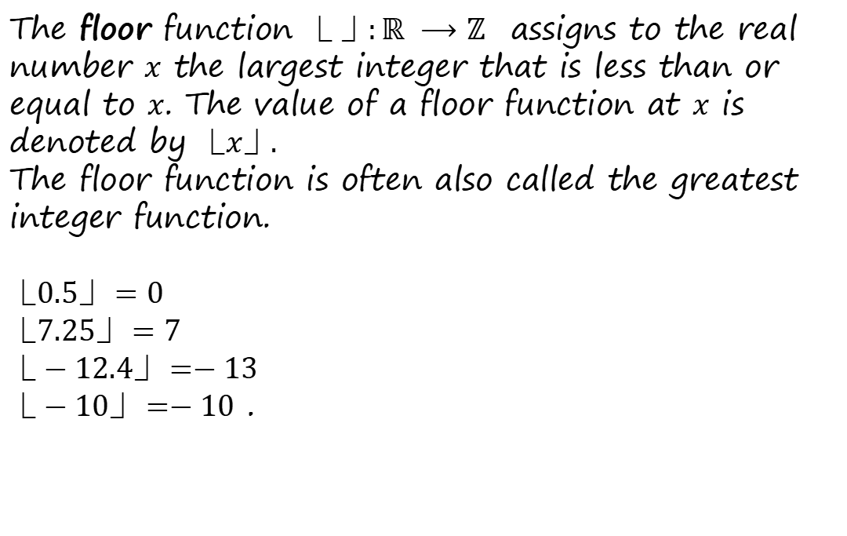
Special Functions: Floor Function
The floor function $⎿ ⏌:ℝ ⟶ℤ$ assigns to the real number $x$ the largest integer that is less than or equal to $x$. The value of a floor function at $x$ is denoted by $⎿x⏌.$
The floor function is often also called the greatest integer function.
$⎿0.5⏌=0$
$⎿7.25⏌=7$
$⎿−12.4⏌=−13$
$⎿−10⏌=−10$ .
7
7.25
8
-13
12.4
-12

Slide 32
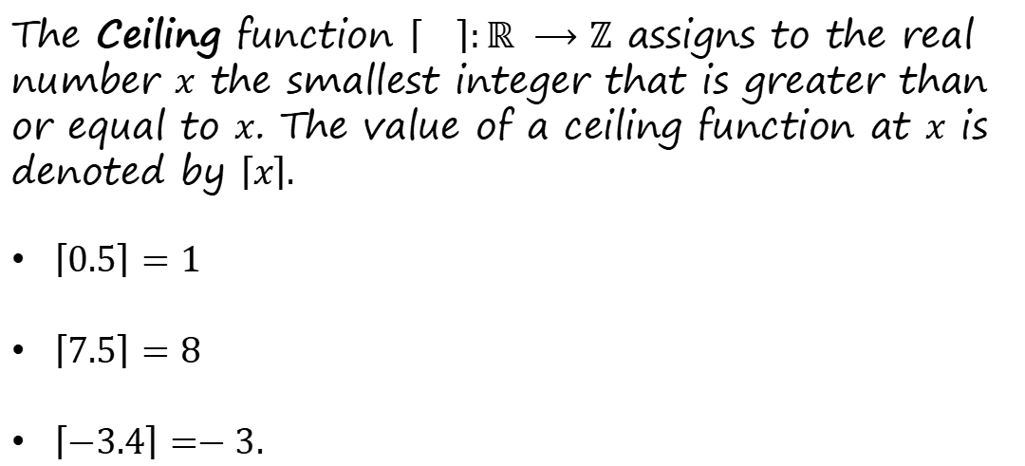
Special Functions: Ceiling Function
The Ceiling function $\left\lceil \right\rceil :ℝ ⟶ℤ$ assigns to the real number $x$ the smallest integer that is greater than or equal to $x$. The value of a ceiling function at $x$ is denoted by $\left\lceil x\right\rceil .$
$\left\lceil 0.5\right\rceil =1$
$\left\lceil 7.5\right\rceil =8$
$\left\lceil −3.4\right\rceil =−3.$
0
0.5
1
-4
-3.4
-3

Slide 33

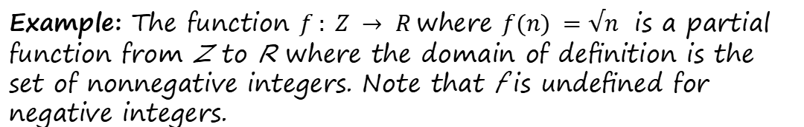
Partial Functions
Definition: A partial function f from a set A to a set B is an assignment to each element a in a subset of A, called the domain of deﬁnition of f, of a unique element b in B. The sets A and B are called the domain and codomain of f, respectively. We say that f is undeﬁned for elements in A that are not in the domain of deﬁnition of f. When the domain of deﬁnition of f equals A, we say that f is a total function.
Example: The function $f : Z → R$where $f(n) =√n$ is a partial function from Z to R where the domain of deﬁnition is the set of nonnegative integers. Note that f is undeﬁned for negative integers.
$$f\left(n\right)=\sqrt{n} if n≥0$$

